Slide 1
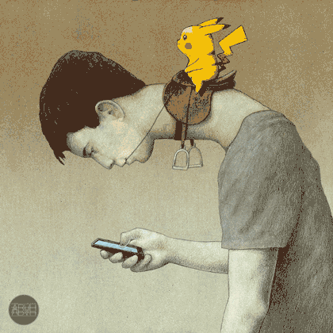
Facebook Society: Losing Ourselves in Sharing Ourselves
Roberto Simanowski
Notes:
50 Miniutes

Slide 2
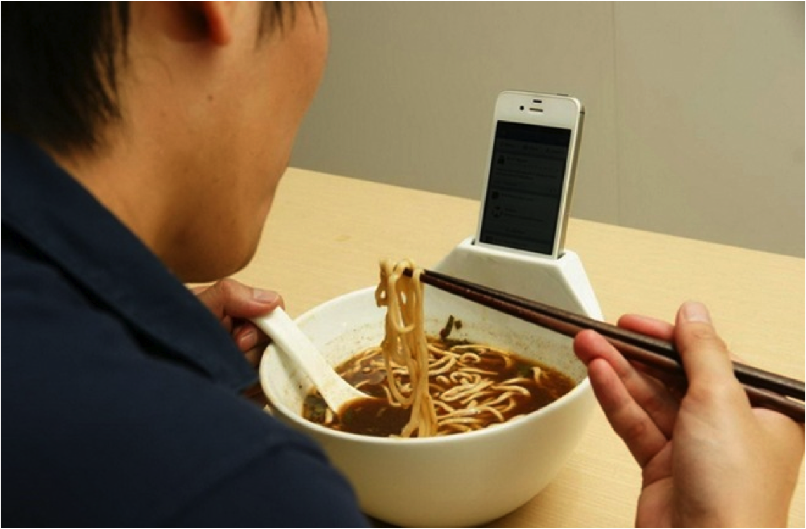
Notes:
What we see here could be a modern-day Faust. Faust before he meets Mephistopheles. The Faust of Goethe’s play Part I, Scene I: “Night” which starts with these words

Slide 3
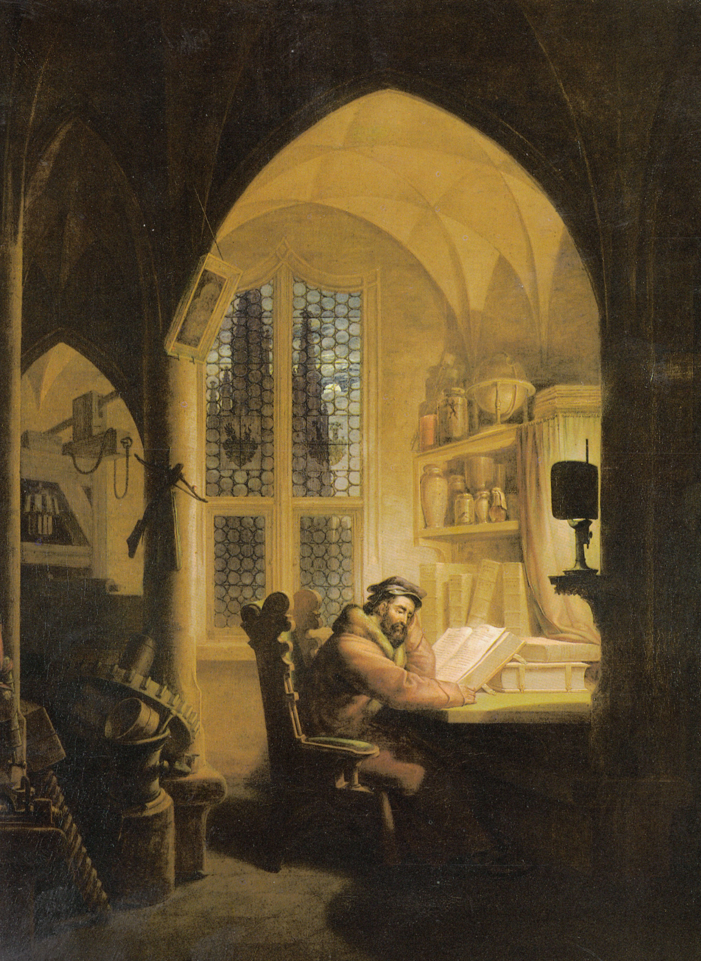
Ah! Now I’ve done Philosophy,
I’ve finished Law and Medicine,
And sadly even Theology:
Taken fierce pains, from end to end.
Now here I am, a fool for sure!
No wiser than I was before ...
What’s worth knowing, I can’t say,
I can’t say what I should teach
To make men better or convert each.
... Understand whatever
Binds the world‘s innermost core together
Notes:
The Faust we see in this scene is desperate for one reason: he still doesn’t …
This is the Faust of Kant who defines Enlightenment as: …

Slide 4
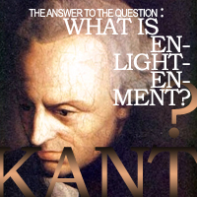
... ENLIGHTENEMENT
IS MAN‘S EMERGENCE
FROM HIS SELF-IMPOSED
IMMATURITY ...
Notes:
That the person in our picture is eating while reading is not important – this only demonstrates his devotion to knowledge. That the person is reading from a smart phone is also not important – this only proves his keeping up with his time. What is important is that the content on his smart phone is not a book or an essay

Slide 5
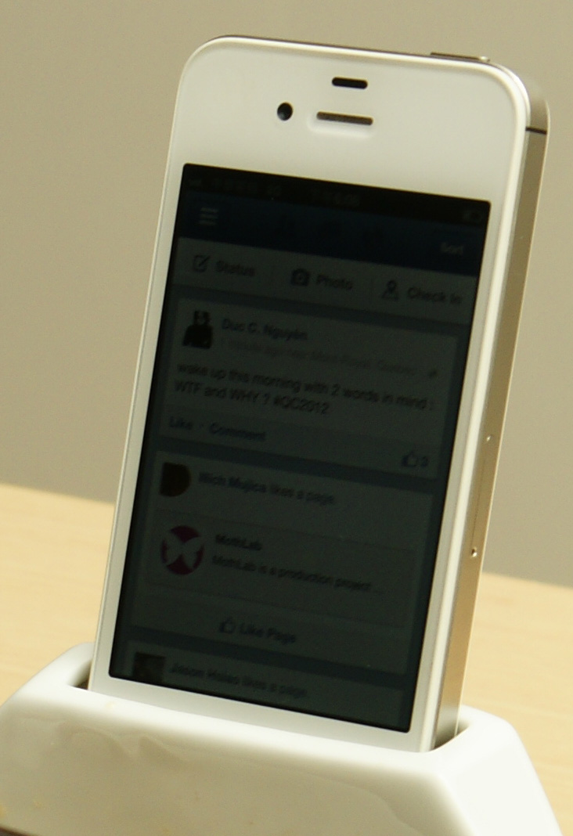

Notes:
To be sure, news in this case doesn’t mean news as in political news, something that people should know in order to keep up with world affairs. In the world of Facebook news means “what is on your mind”, news is whatever happens to you

Slide 6
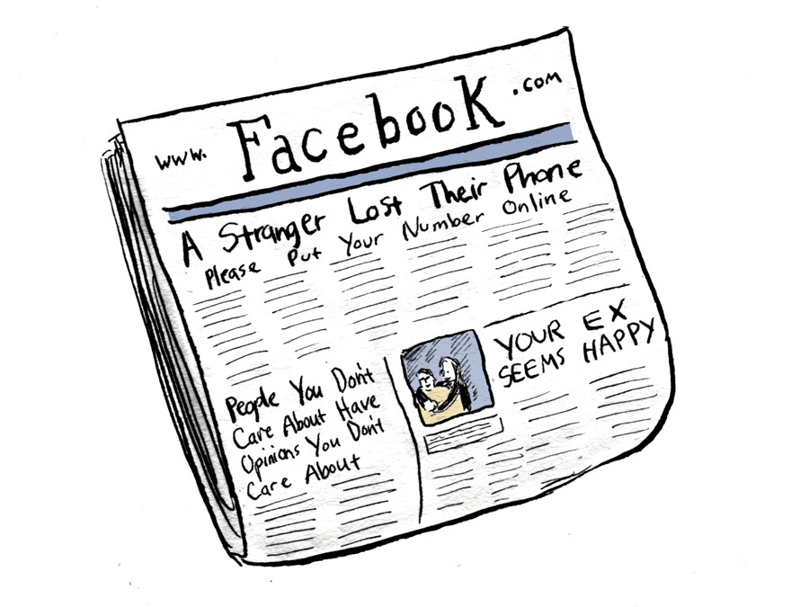
Vernacular information
Notes:
Vernacular information such as the fact that your Facebook friend has made new Facebook friends or that another friend has purchased the latest model of ultra-responsive running shoes.

Slide 7
Faust?
feared not to understand the world
eager to change the world
typical Millennial, a run-of-the-mill representative of the generation like
Notes:
At that point we may develop some doubt as to whether our soup-eater could really be a modern-day Faust. As you will recall: before Faust met Mephistopheles he feared he was not able to understand the world. After Faust meets Mephistopheles he becomes eager to change the world.

Slide 8
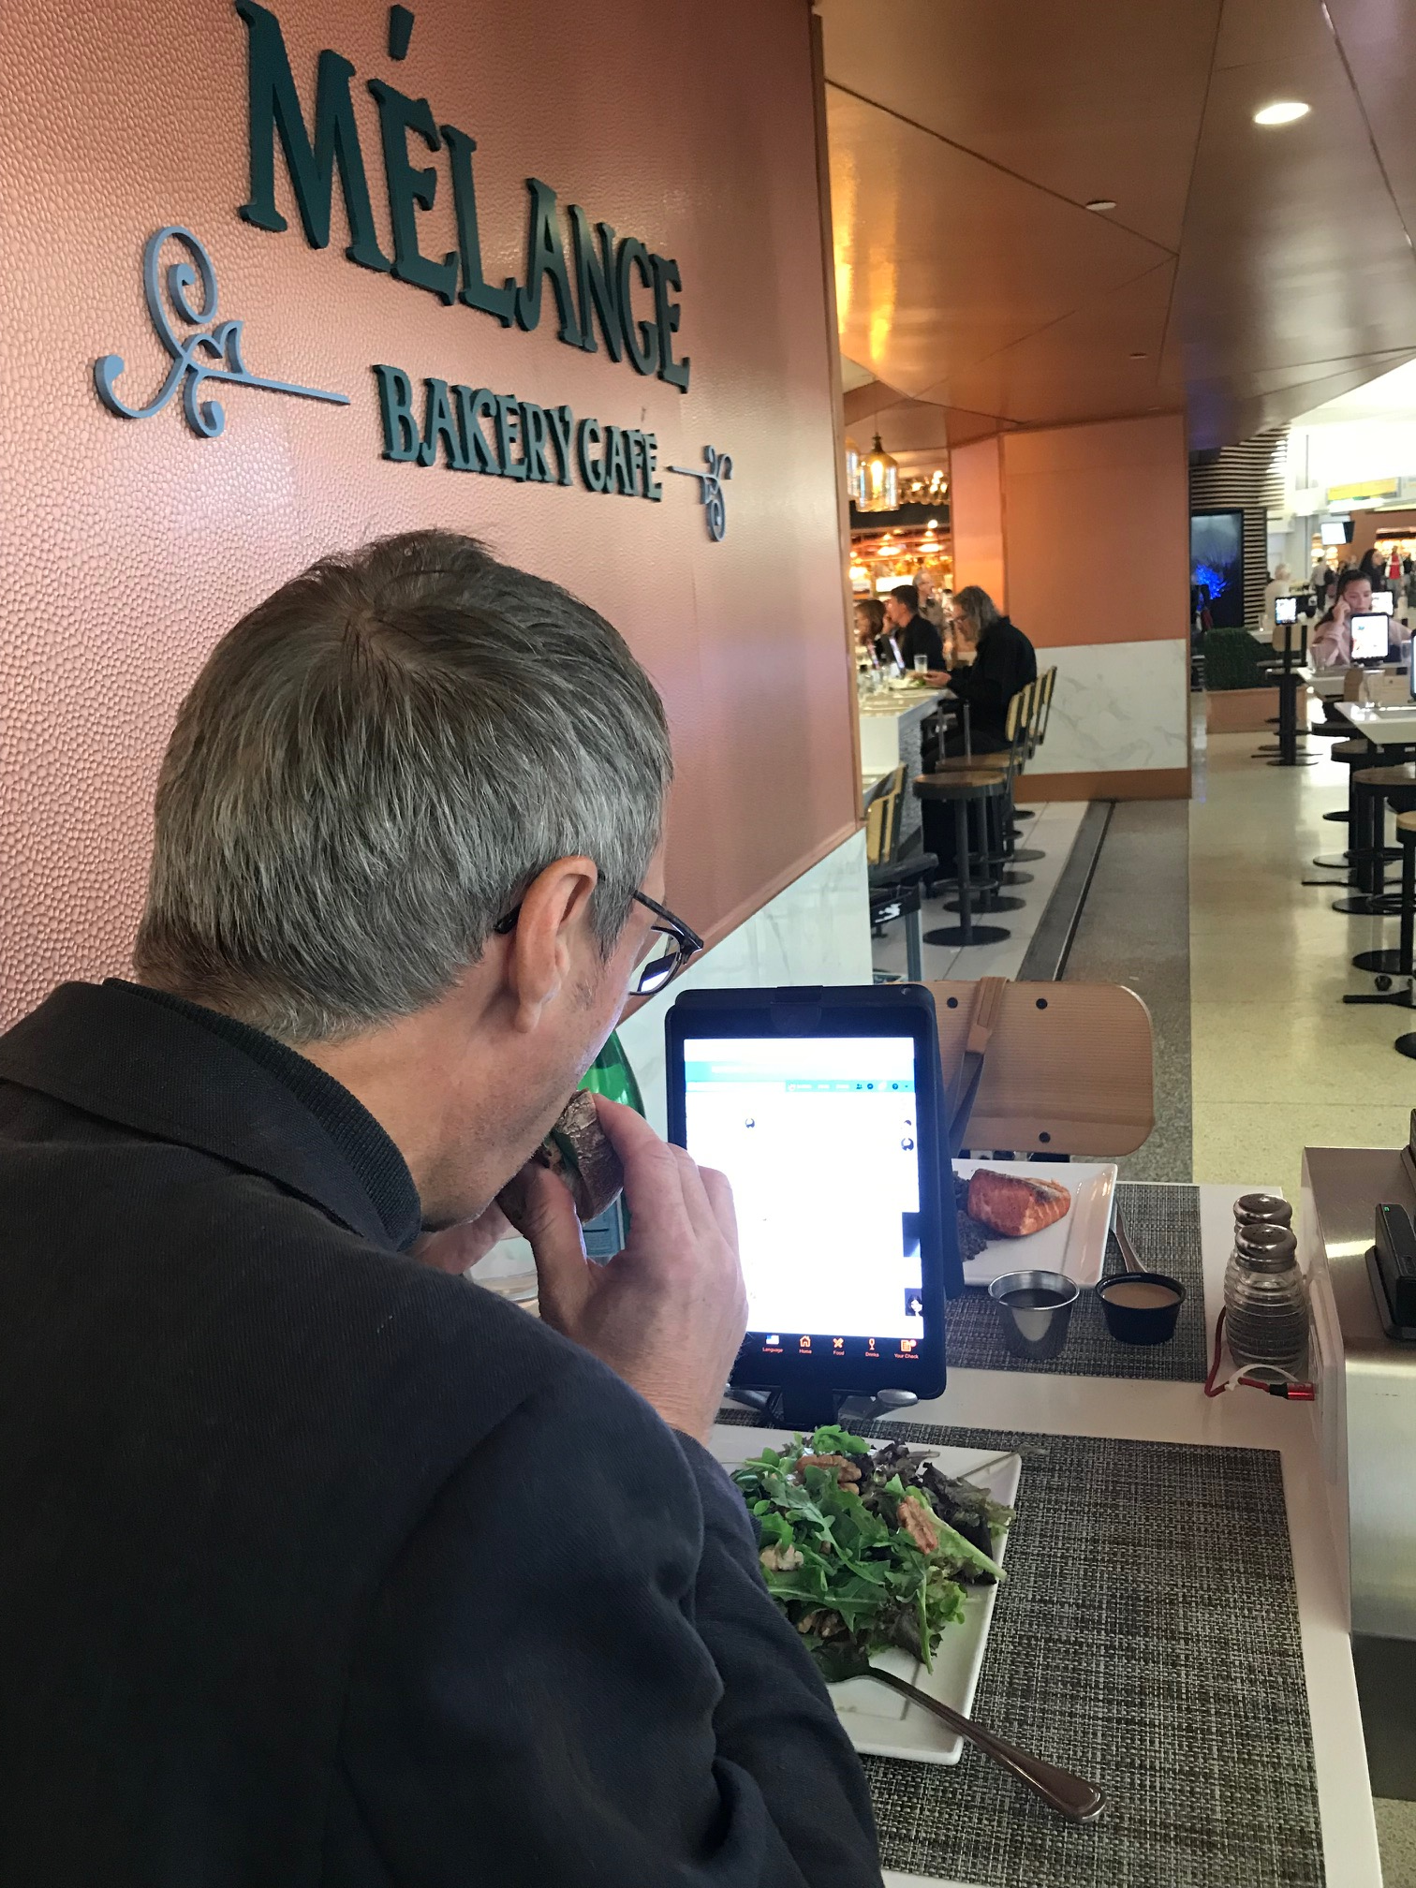
Notes:
>And though the Antiloneliness-Ramen-Bowl, a product from a Design Startup in Taiwan, failed to generate much market attention, you don’t have to go far to encounter similar devices. … Is ours still the time of Faust?

Slide 9
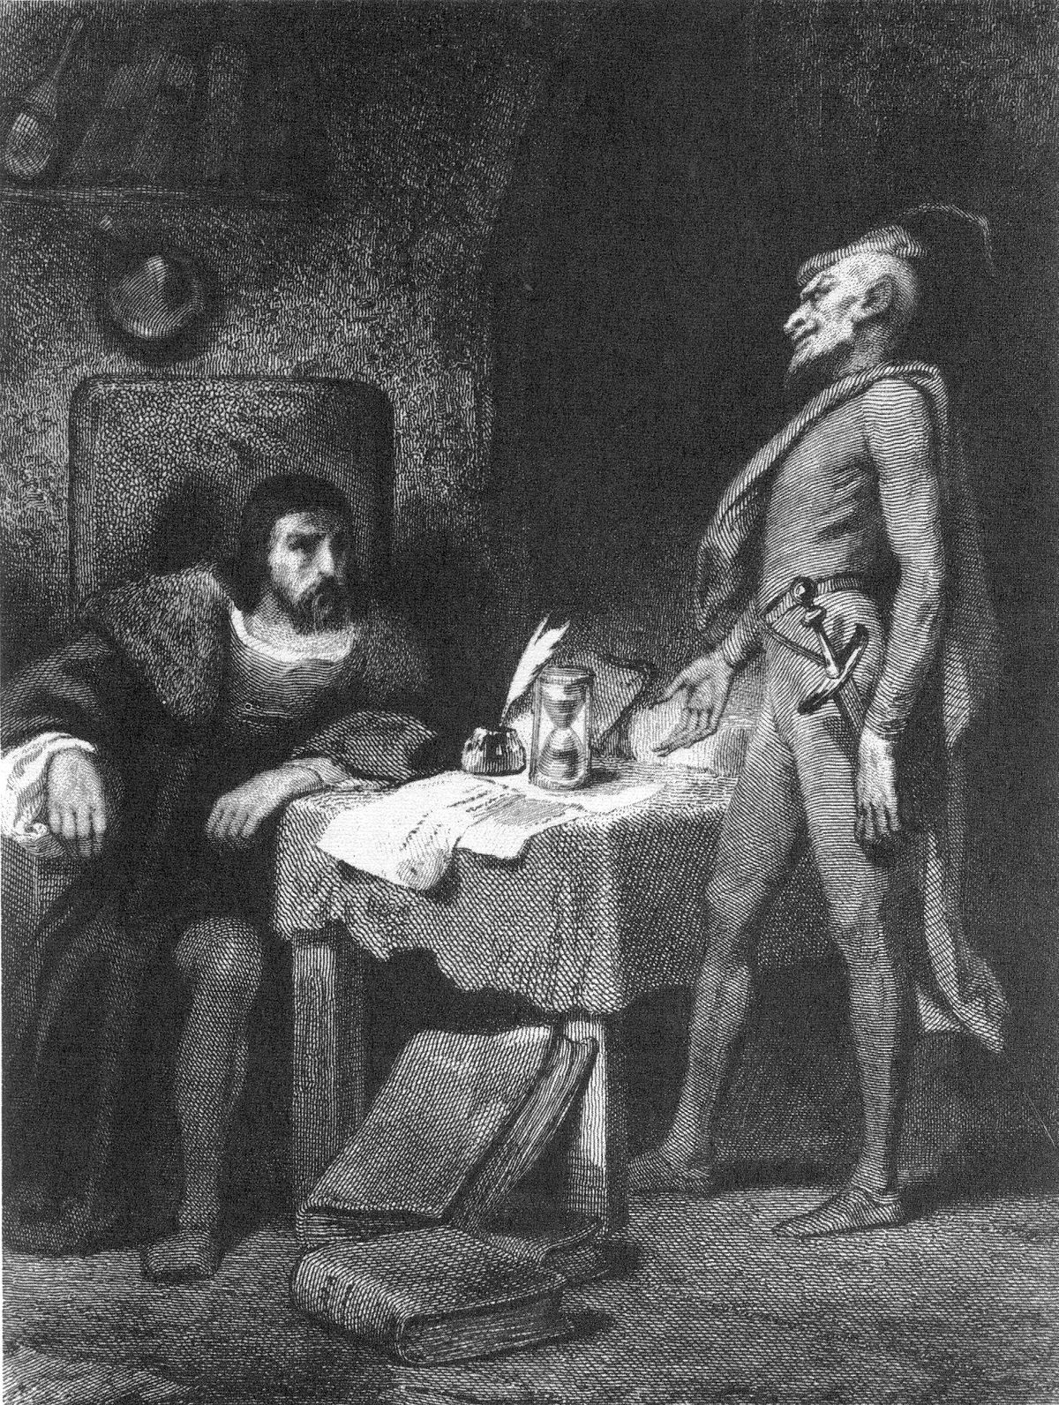
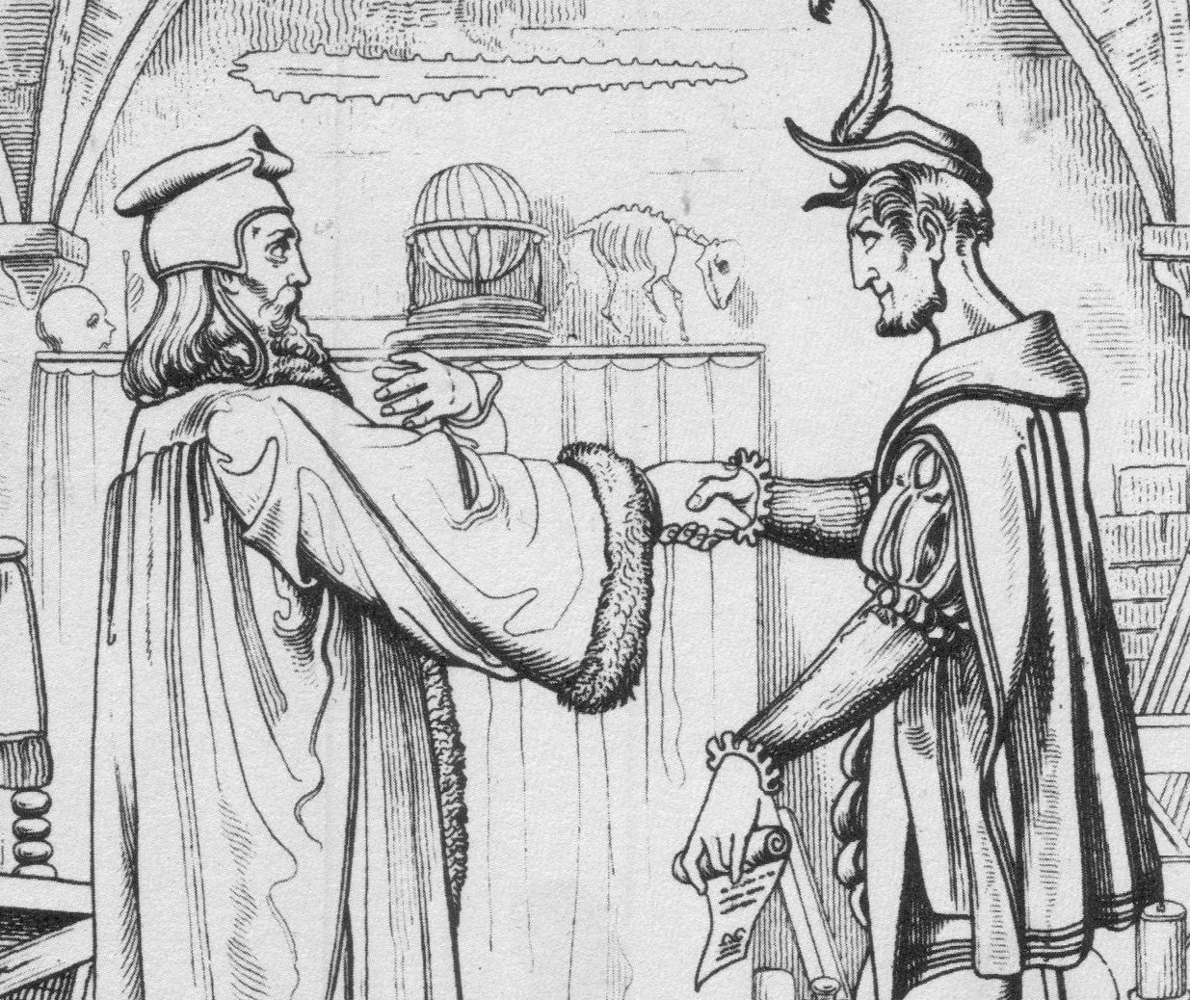
1. FAUST TODAY
Faust about woman?
About changing the world!
His pact is a wager!
IF EVER I PLEAD WITH THE PASSING MOMENT:
LINGER AWHILE, OH HOW LOVELY YOU ARE!
THEN SHUT ME UP IN CLOSE CONFINEMENT,
AND I’LL GLADLY GO TO MY DESTRUCTION
?

Slide 10
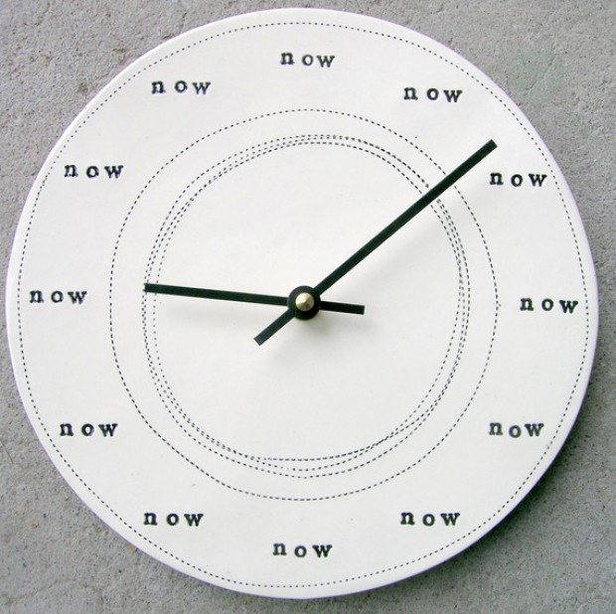
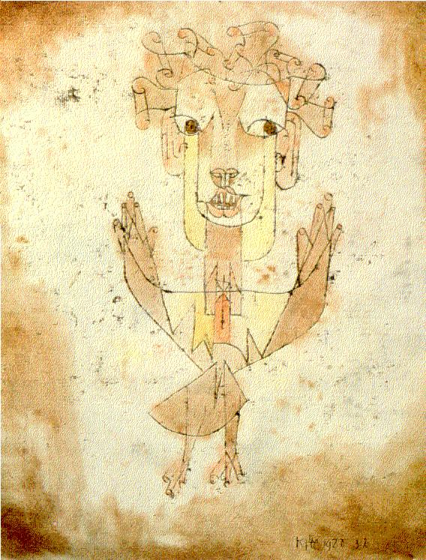
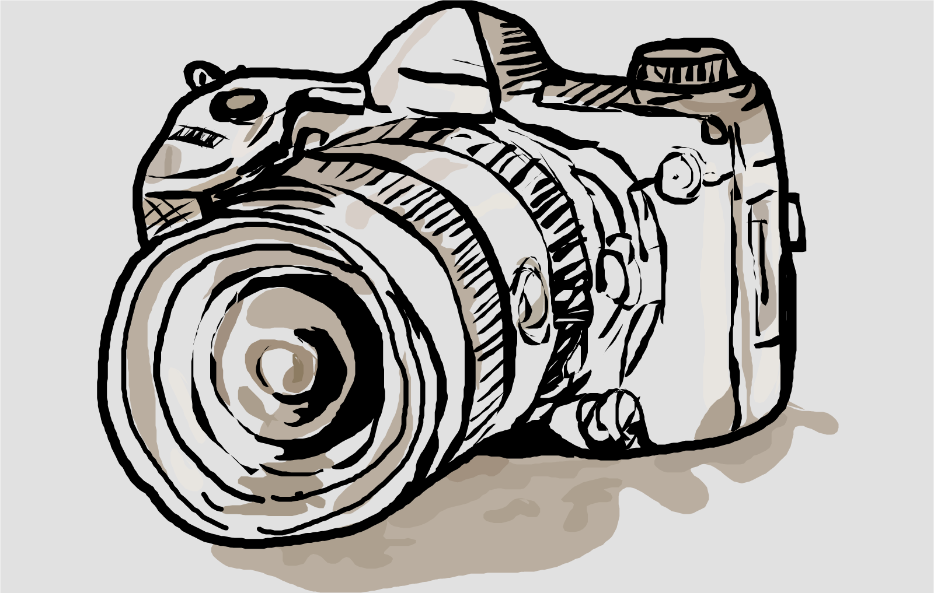
Are we all hopeless losers of Faust’s bet?
Who still wants to change the world?
Who among us doesn’t constantly hold onto the moment?!
Notes:
… >Who still wants to change the world? Who still believes, like Faust (or Adorno), that the history of humankind hasn’t even really begun yet? Who among us doesn’t constantly hold onto the moment as if never letting go of it were of the essence?

Slide 11
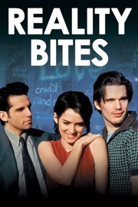
Are we all hopeless losers of Faust’s bet?
Who still wants to change the world?
Who among us doesn’t constantly hold onto the moment?!
1994
Troy Dyer:
“I am not under any orders
to make the world a better place”
Notes:
> Generation EX already feels relieved of this mandate (to change the world). As the character Troy Dyer puts it in the 1994 cult film Reality Bytes:

Slide 12
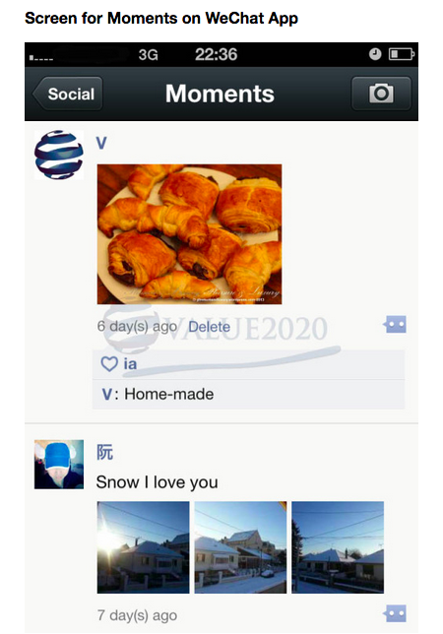
Are we all hopeless losers of Faust’s bet?
Who still wants to change the world?
Who among us doesn’t constantly hold onto the moment?!
But: More
is less!
Notes:
But: More is less! Along with the number of moments that are held onto, the suspicion is also growing that something is wrong.

Slide 13
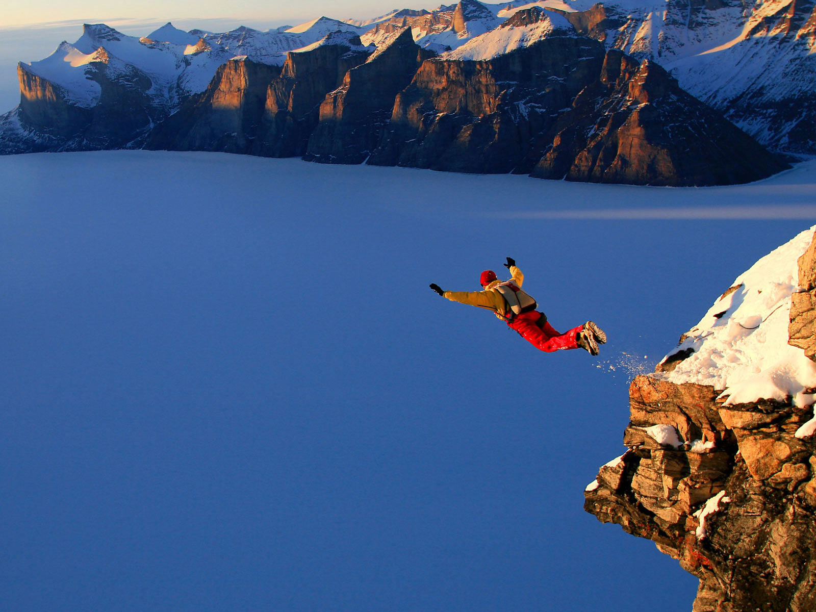
2. PRESENT SHOCK
1980s: “experience society”
Bauman “From Pilgrim to Tourist - or a Short History of Identity” (1996):
Liberated from old structures, traditional role models and imposed life plans, the subject develops an identity that does not let itself be determined by the past or obligated by the future. …
The overall result is the fragmentation of time into episodes … assemblage of random moments: a continuous present
Notes:
Entire talk a full hour

Slide 14
2. PRESENT SHOCK
The subject is free to do whatever it wants, without having to want anything and also without knowing what it should want.
Thus it lives on, in the delirium of an endless present, ceaselessly under-way from moment to moment.
present-relatedness also creates pressure and anxiety
Notes:
Entire talk a full hour

Slide 15


2001
2014
Without a deeper link to the rest of time
every event is always simultaneously
not enough and much too much.
Notes:
Entire talk a full hour

Slide 16
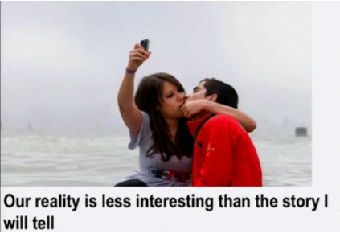

Slide 17
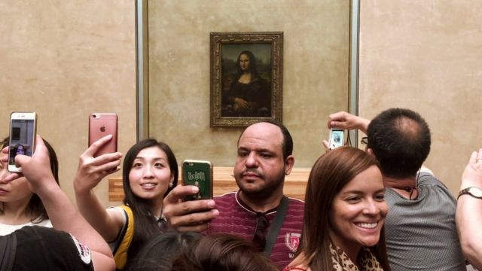

Slide 18
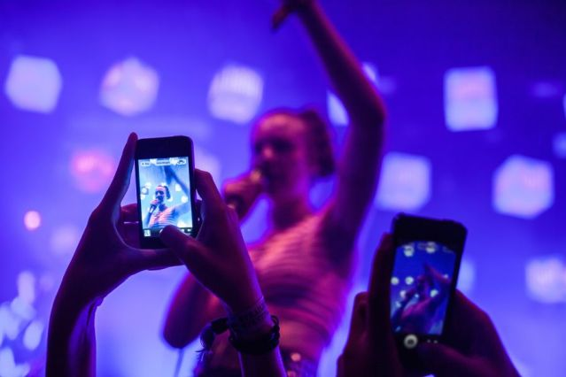

Slide 19
We are not on our way to the future.
We experience the moment with less intensity than Faust who must never asked it to linger.
We think we have done our part if we bring home a souvenir from the museum shop and a video from the rock concert.
We are not Faust!
Who are we?

Slide 20

3. NETWORK SMOKE
The smartphone is the cigarette of the 21st century.
A self-protection whenever we are confronted
with an uncomfortable, pressing present.
Notes:
… >The problem of the pressing present has been announced as early as 1933 in Walter Benjamin’s essay Experience and Poverty

Slide 21
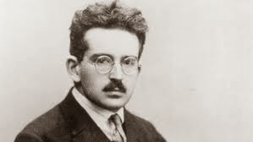
Walter Benjamin Experience and Poverty (1933): souvenir as a socially acceptable form
of liberation from experience
Notes:
--- > 40 years later, in her 1973 study On Photography, Susan Sontag endorsed this perspective saying:

Slide 22
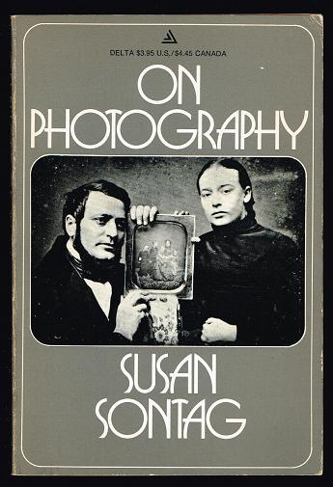
PHOTOGRAPHY IS A DEFENSE AGAINST ANXIETY, AND A TOOL OF POWER THAT HELPS TOURISTS TAKE POSSESSION OF SPACE IN WHICH THEY ARE INSECURE.
1973
Notes:
… > This perspective earlier already in

Slide 23
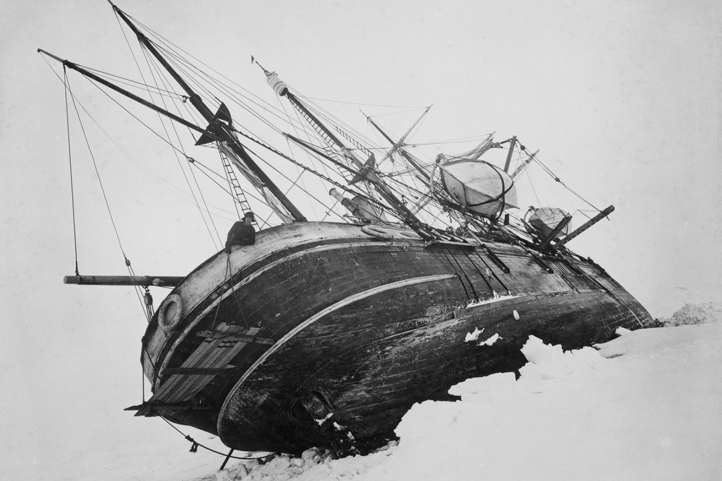
Béla Balász The Spirit of Film (1930)
example of the shipwreck in Shackleton’s Trans-Antarctic Expedition (1914–1917)

Slide 24
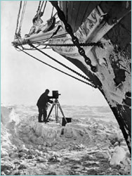
This is a new form of human consciousness, which is given to man by the camera. As long as these men don’t lose consciousness, their eye looks through the camera’s lens and imagines the scene in the lens as present. Presence of mind becomes presence of the image.
Notes:
Shutterstock, http://www.shutterstock.com/pic-355905242/stock-photo-hugging-cuddling-people-group-of-people-on-a-cuddle-party.html

Slide 25
The camera provides security. It is a form of self-consciousness. The inner process of taking account of something has been turned inside out. […]
We don’t keep shooting as long as we are conscious, we are conscious as long as we keep shooting.

Slide 26
“The inner process of taking account of something has been turned inside out.”
The camera provides security by becoming
a site of externalized reflection;
consciousness is reduced to the act of witnessing, which provides a hold at the very moment of falling.
Us?

Slide 27

We photograph things in order to drive them out of our minds
Notes:
> Many notions in history about the psychological function of photography …

Slide 28
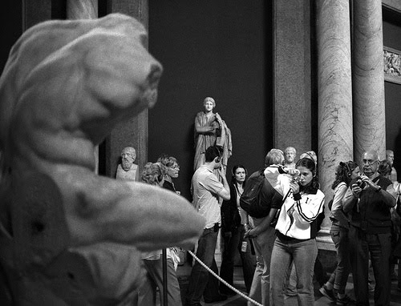
Standing face to face with one of the great wonders of the world,
the overwhelming majority of people have no wish to experience it, preferring instead that the camera should.
(Giorgio Agamben: Infancy and History: On the Destruction of Experience)

Slide 29

1999
“Why do people record TV programs instead of watching them?”
But: Left to machines, delegated experience runs empty.
Notes:
… > We need more than a machine. We need a SOCIAL machine

Slide 30

SNS: immediate sharing
delegation as communication
rather than escape
Notes:
… >People don’t retreat helplessly into their own cloud of smoke; they feel that they are active members of a community, a “machine” for dealing with the present, in which each act of communication responds to the lived experiences of the others and—a “group cuddling” by likes—“takes care of” their experiences as a kind of labor of love.

Slide 31


Slide 32
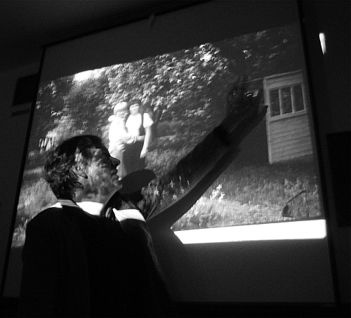
before we had the slight-show where we delegated/shared our experience
Notes:
>before we had the slight-show where we delegated/shared our experience … or the late-night recollections over a glass of wine and a table littered with photographs

Slide 33
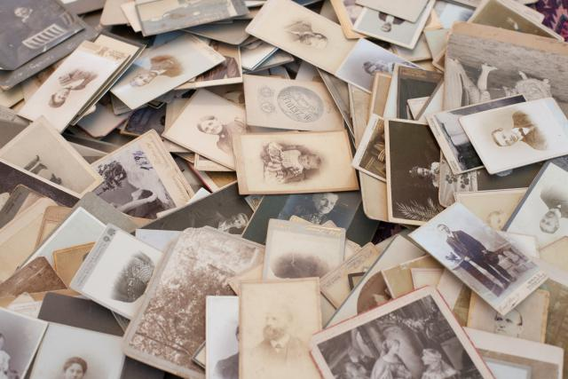
Who has time to have a second look at all the photos it once seemed so important to create?
We prefer instead that our social network looks.
Anecdotal evidence

Slide 34
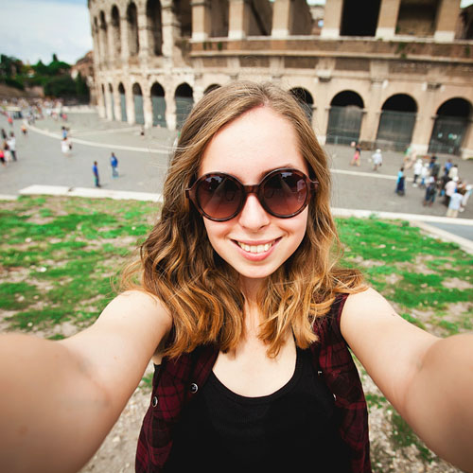
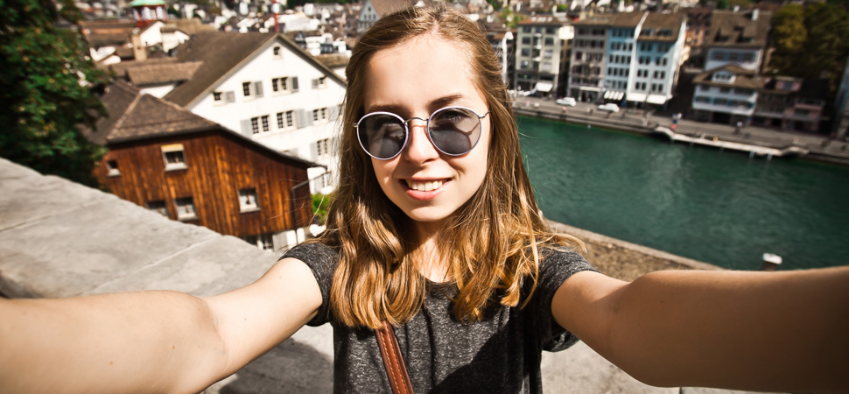
What for many people looks like narcissism is basically a cry for help
to the network friends, who should liberate us from the present moment
that, to judge by the photos, is making us so happy.

Slide 35
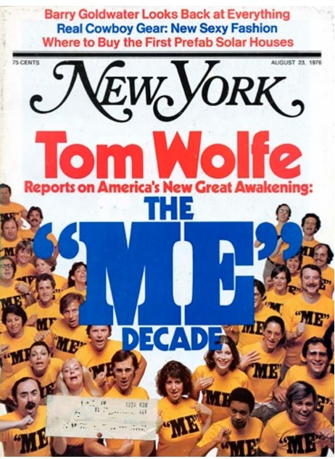
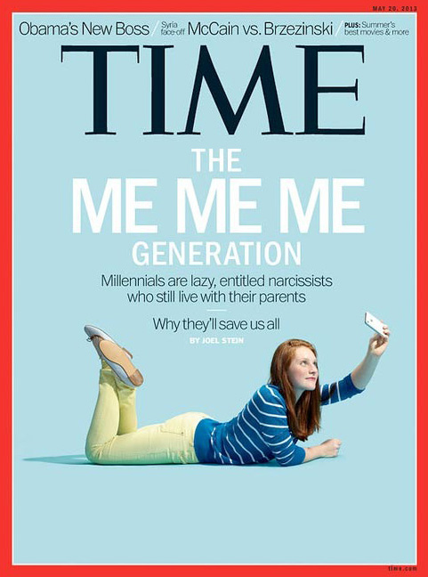
Me!
Me?
1976
2013

Slide 36
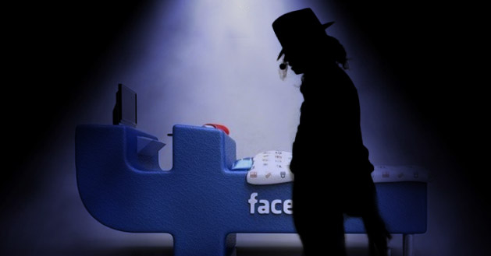
Flight from both solitude and society!
Wherever we
may happen
to be, in the
social space
of the digital
media we
feel safe
and secure.

Slide 37
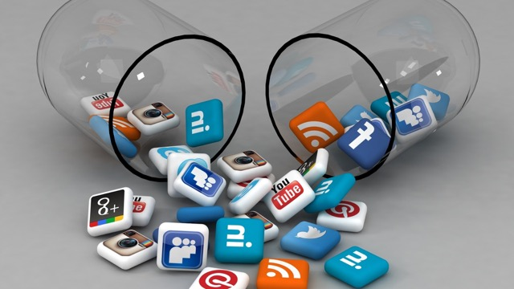
Notes:
> To be sure, Facebook is only the most important social network that entices us to escape from whatever it is we happen to experience.

Slide 38
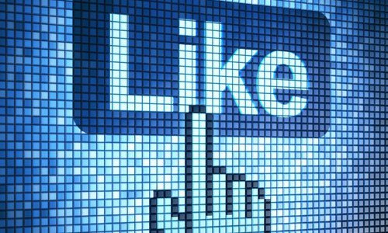
Notes:
> What we hope for are Likes, the ultimate currency in this economy.

Slide 39
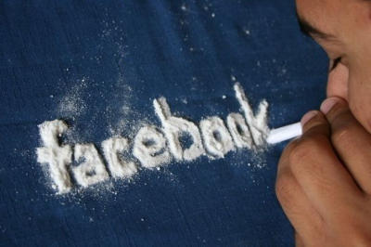
Dopamine-Feedback-Loop
Whistleblower

Slide 40
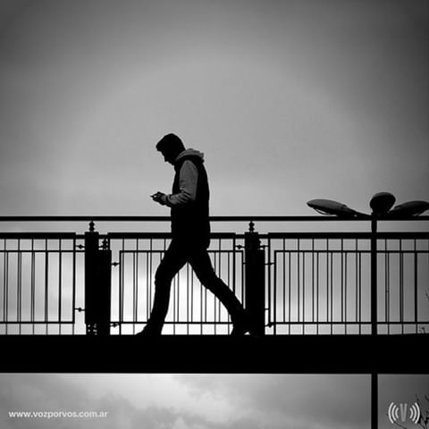
here and now now permanently replaced by the there and now of the social network
Notes:
> One central characteristic of Generation Like is its constant absence: the here and now is permanently replaced by the there and now of the social network

Slide 41
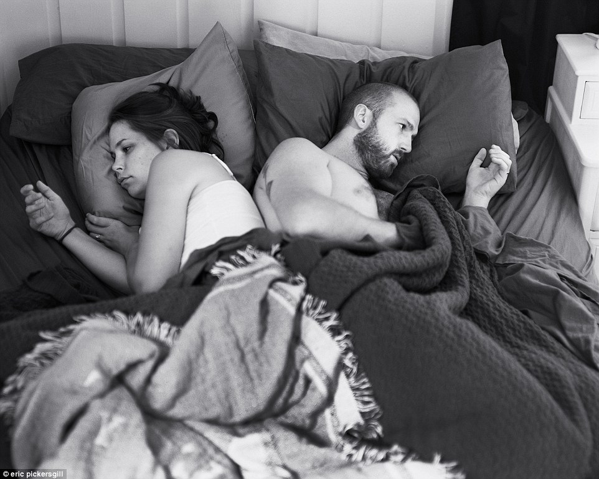

Slide 42
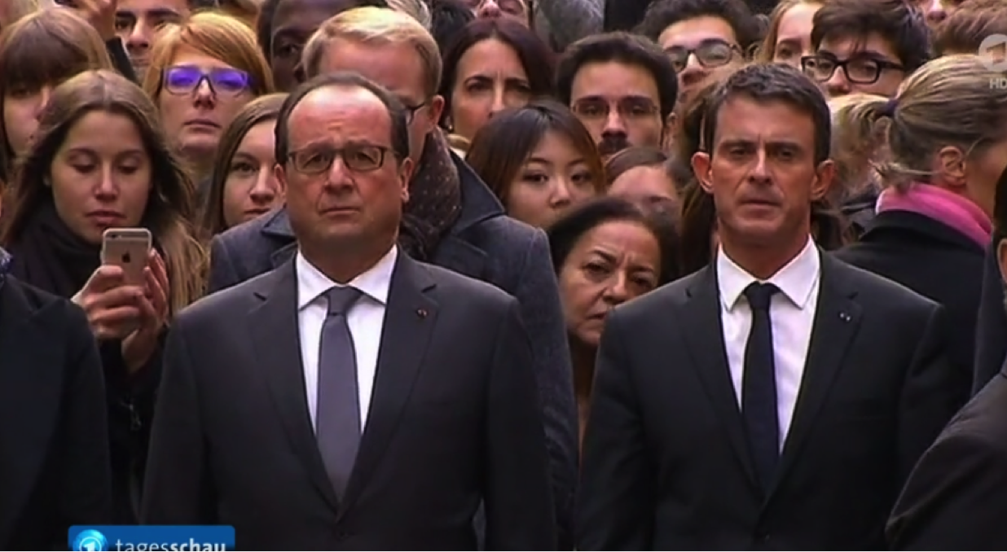
November 16th in 2015
ceremony to honor the 129 victims of the terror attack
4. THE FRENCH WOMAN
Notes:
The event took place at the Sorbonne, and what we see in this image is the minute of silence that the President of France, Holland, requests the audience to observe.

Slide 43
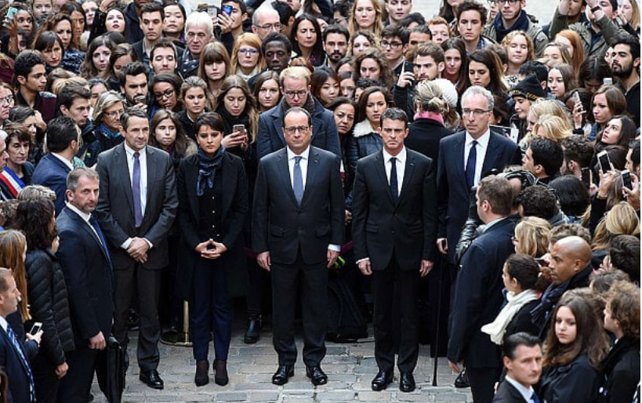
Notes:
> Of course, she is not the only person on the phone

Slide 44
Notes:
> The act of taking pictures has become so ingrained in our culture that it has ceased to register as disruption. At least this is the impression I got when I asked my HK students to comment on this very image.

Slide 45
The young woman’s action is not an act of disrespect, but one of sympathy toward the victims:
“By sharing the moment on her social network she underscores and amplifies the importance of uniting
in the fight against terror.”
Notes:
… > Other students went further in their defense of their ‘generation mate’ and excused her behavior altogether >

Slide 46
“communication today is more multiple and several communications can exist at the same time”
In other words, a moment of silence is no deterrent to our multi-tasking.
Notes:
… > Such comments make you think of one of the truisms in the media theory of the McLuhan school: First we shape our tools and then our tools shape us – including our perspectives and judgements.

Slide 47
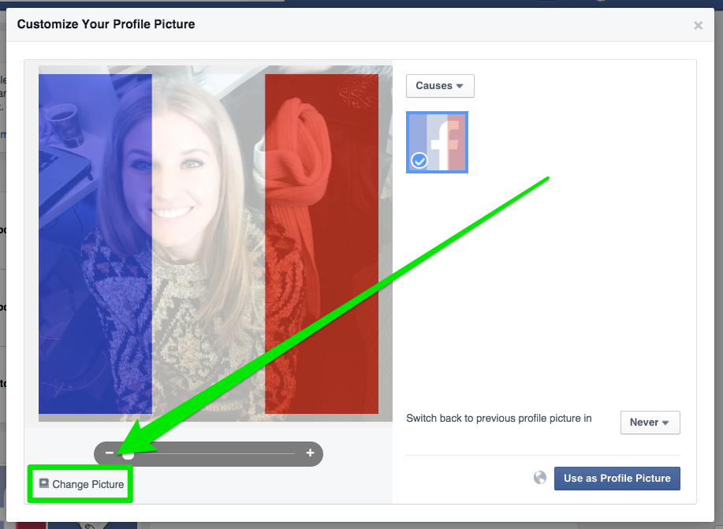
What does it mean if thousands of Facebook users change their profile picture to express their support for France while a French woman on the ground can’t stay away from Facebook during the official mourning minute?
The crucial question is not why she takes a picture, but who is on it.
There is no relevant background that would justify a selfie.

Slide 48
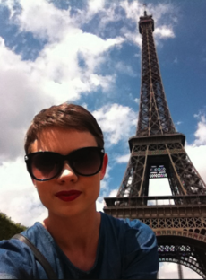

Slide 49
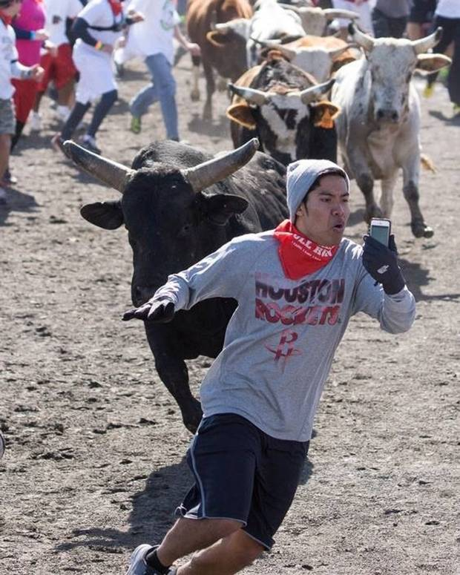

Slide 50
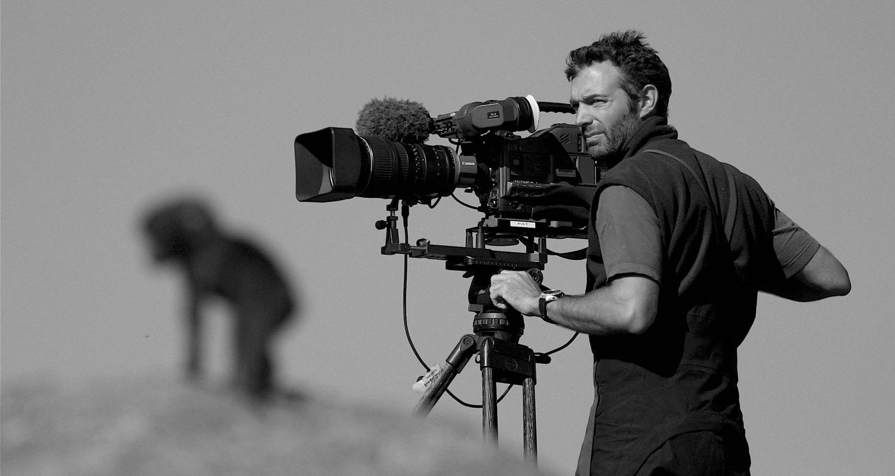
Doesn’t the TV-Camera generate the perfect selfie for her with the president not behind her, but in front of her? Selfie?
Notes:
… > Is it not enough to know she will be the woman behind the President in the news tonight and in the newspapers tomorrow? This is exactly the point. If she is behind the president the photograph she takes can’t possibly be a selfie.

Slide 51
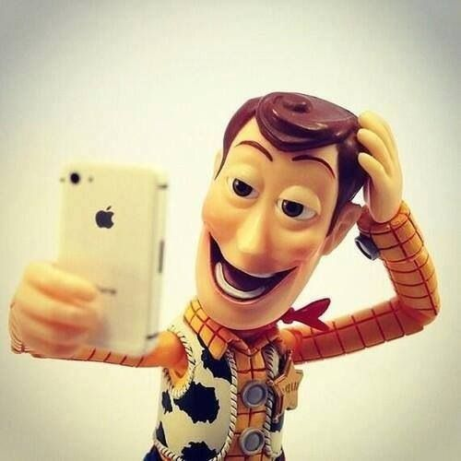
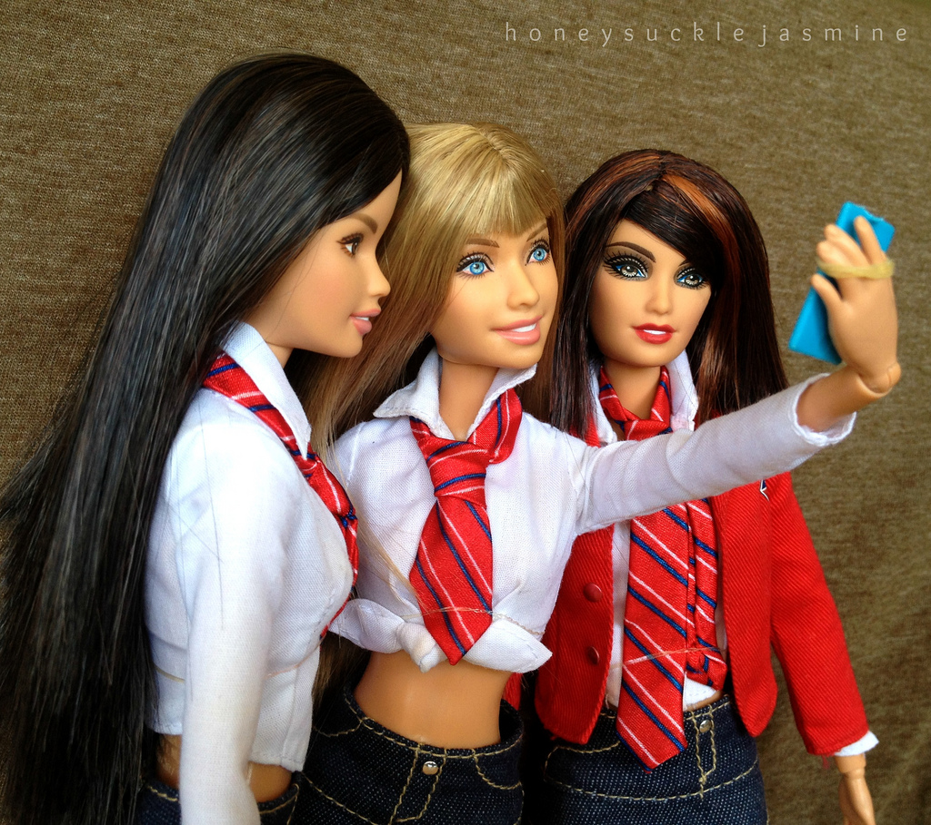
Do we only take selfies to be on the picture? Web 2.0 – Produser!

Slide 52
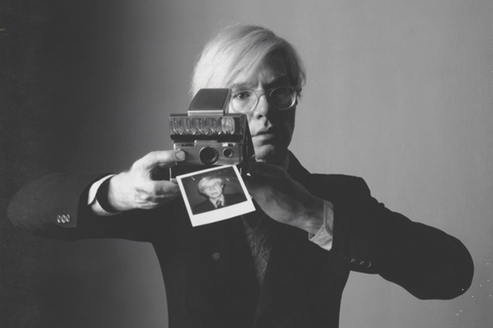
The self/woman wants to be both, the photographed and the photographer.
In shooting back/reversed ‘selfie’ the woman symbolically regains control
Notes:
… >This command cannot be outsourced to the TV-camera. The only way to turn the objective photo into a selfie is to shoot back.

Slide 53
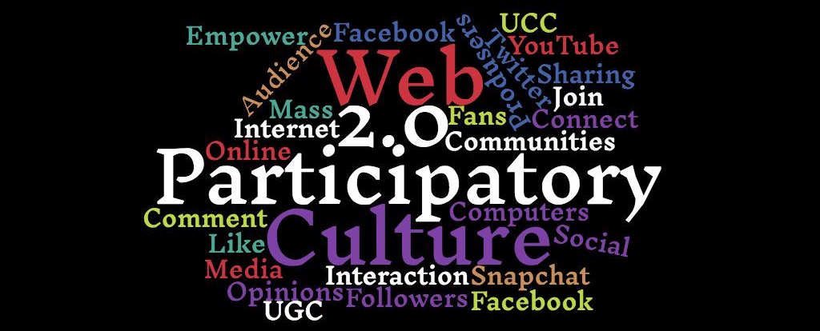
?
5. DAETH OF THE LISTENER
Millennials are not equipped to be inactive/’passive’ .
Notes:
Millennials are not equipped to be inactive, they nurture the belief that patiently reading something or listening to somebody denote a passivity that should be avoided at all costs.

Slide 54

Picard regards the radio as meaningless machinery of permanent noise and bemoans the fact that words no longer grow out of silence and reflection, but multiply thoughtlessly without patience or respect
There is more silence in a person
than he can use in his lifetime.
1948

Slide 55

Silence, Contemplation, Solitude?
Notes:
Values such as contemplation, or even solitude are foreign concepts to the Generation Like. If one wishes to bring them back into their lives, one may need special measures.

Slide 56

May 22, 2016
“Let our brain – never free from information over-load from a smart phone, TV or computer – relax! Let’s enjoy just thinking nothing!”

Slide 57
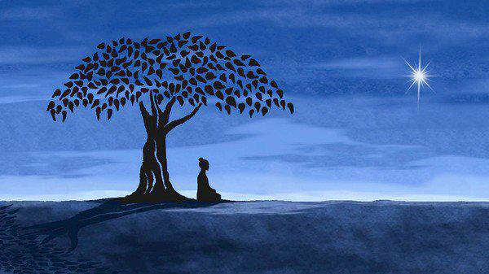
1500/60/90Min
Notes:
How could one win this competition? Answer: by having the most stable heart rate among all participants. Who do you think won? A well-known 28 year-old local rapper who was so physically and mentally exhausted from preparing an album that he “just wanted to relax for a while.”

Slide 58
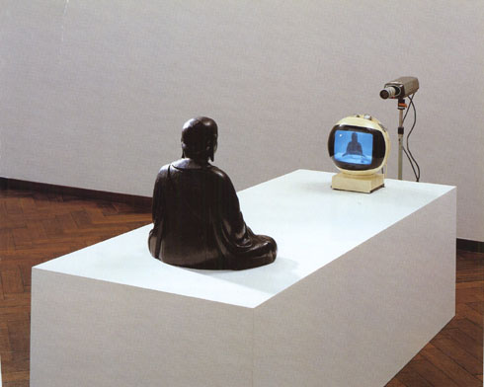
TV Buddha, 1974
Notes:
A good prior to the fact-comment on this space-out event in Seoul is a sculpture by the city’s own Nam June Paik, father of video art.

Slide 59
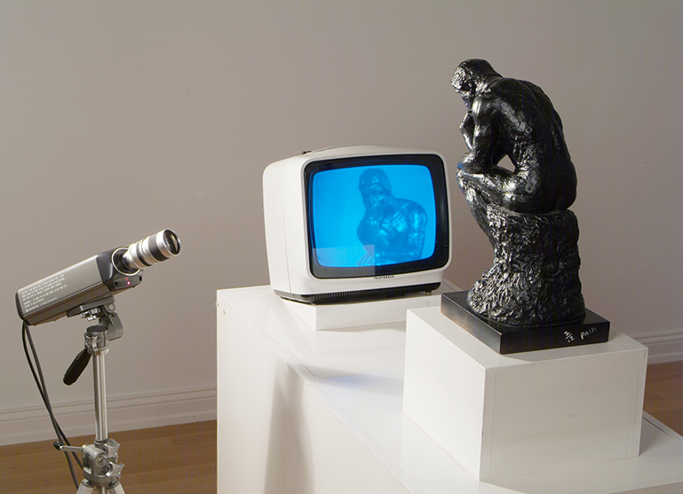
the self contemplates itself as it is portrayed back to itself by the camera
TV Rodin, 1976
TV Buddha, 1974
stillness of the film in Paik’s sculptures = Picard’s silence

Slide 60
TV Rodin, 1976
TV Buddha, 1974
Antiloneliness-Ramen-Bowl
the object of our gaze has changed: SNS feed
there is still a ‘camera’ operating at the back-end: watching algorithm
Notes:
… > But: In a certain sense, the picture of the Millennial eating soup is nothing but an update of Paik’s video sculptures, though it misses the camera. But: …

Slide 61

Cogito,
ergo sum.
I post
therefore I am.
It posts therefore I am.
Look at your network and you shall see yourself.
Notes:
>This ‘camera’ [the algorithm] provides a timely update to the Cartesian cogito

Slide 62
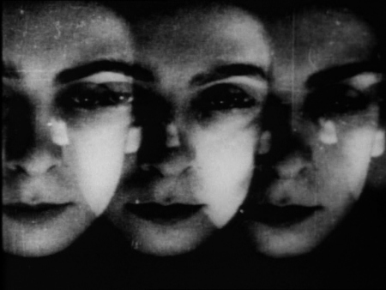
6. AUTOMATED AUTOBIOGRAPHY
1.: my social network is less me than it appears = 3 narrators

Slide 63
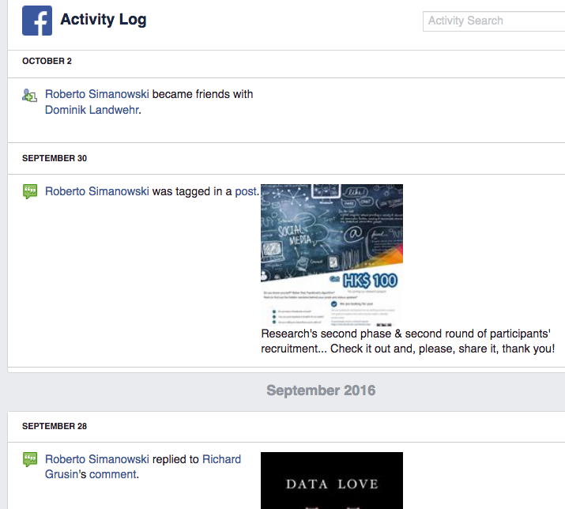
1. me
2. friends
3. algorithm:
- feed, filter-bubble
- movie on Netflix
song on Spotify
event attended
places visited

Slide 64

FB as new diary? A ‘diary’ that writes itself in real-time! Even my own texts.
post-human, algorithmic Auto/Biography
Notes:
> Even texts I do write myself (in a post or as comment on somebody else’s post) will be captured in that framework: verbatum, in real-time, as opposed to a summary, as one would do in a diary entry

Slide 65

“communicative ready-mades”
real acts are copied into the environment of my Facebook diary

Slide 66

reliable narrator arrives the moment it has become posthuman: camera

Slide 67

IN THE PAINTING THE MEANING OF THE OBJECT TAKES ON SPATIAL APPEARANCE, WHEREAS IN PHOTOGRAPHY THE SPATIAL APPEARANCE OF AN OBJECT IS ITS MEANING.
painting is the materialization of how something is perceived,
the photograph is the recording of what is present

Slide 68





Variations of a reading woman
Notes:
(A Woman Reading by Ivan Olinsky, Young Girl Reading by Pablo Picasso)

Slide 69

CONTEST BETWEEN THE WILL OF THE SUBJECT TO IMPOSE ORDER, A POINT OF VIEW, AND THE WILL OF THE OBJECT TO IMPOSE ITSELF IN ITS DISCONTINUITY AND MOMENTARINESS …
THE OBJECTS GIVE A FACTUAL REPORT ON THE STATE OF THE WORLD IN OUR ABSENCE
(Jean Baudrillard)
Today the prevalence of objects against the will of subjects takes place each and every time a moment ceases to be experienced or reflected upon and is instead quickly photographed and shared.
In our SNS the object prevails over the subject, but now the object is the Self. One’s personal view of one’s own matters is replaced by the documental recording of these matters.
Notes:
>Half a century later, French philosopher Baudrillard dramatizes such self-annunciation of material things as battle between objects and subjects

Slide 70

Pencil of Nature
The signified object prevails over the “inner truth” the perceptive subject may want to signify
Photo-Graphy
bypassing of consciousness:
“strike against understanding”

Slide 71
This tendency is reinforced by new immersive technologies and features: video live-stream, 360-degree video journalism
constant publicizing of the self by the self seems as escape of the self from the self. Selfie-Generation without Self-
Consciousness

Slide 72



7. PAIK’S FAUST

Slide 73

7. PAIK’S FAUST
1989
Paik’s Faust
13-piece series, issues of contemporary society: environment, economics, art, communication.
Gothic cathedral (Faust; 1480)
wide translucent windows alludes to end of Dark Ages
Gutenberg Galaxy
Enlightenment
TV-Light!

Slide 74

“abundance of light pouring out over our cities
serves not least to increase the darkness.” (1930)
Notes:
> Here light does not originate from outside the stained glass but from inside the machine. This light is similar to the light to which Kracauer refers in his 1930 essay The Salaried Masses. …

Slide 75

Notes:
Galeries Lafayette

Slide 76

Notes:
the permanent illumination, the dizzying glare of screens in contemporary society with its culture of consumption and its cultural industry does not foster enlightenment

Slide 77

Guy Debord: The Society of the Spectacle, 1967
Neil Postman: Amusing Ourselves to Death. Public
Discourse in the Age of Show Business, 1985
Paik’s My Faust represents the opposite of what Faust stands for:
end of desire to understand/change the world and oneself
a Faust deeply entranced in consumer culture in the age of television

Slide 78


Slide 80
Facebook Society: Losing Ourselves in Sharing Ourselves
Roberto Simanowski
Notes:
50 Miniutes

